Slide 1
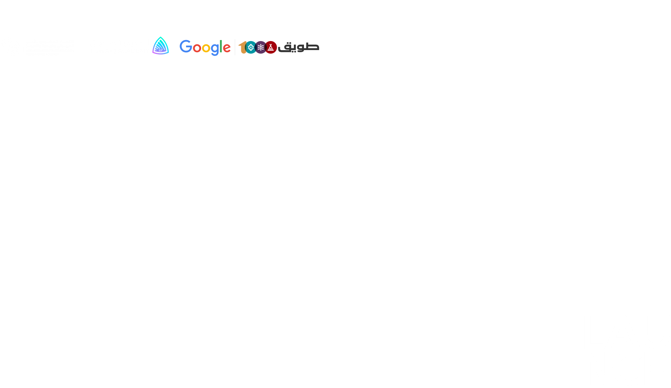

Event Management System

Slide 2
Abstract..
Online event management system is a best way to keep users engaged with the service As technology is growing rapidly we are also moving to technical world where everything we want is to be online. The main aim of this proposal is to develop an online event management system.
Where the admin can add and delete the event and add other
admins.
As for the user, he can register, and after logging in, he can book an event that suits him, and he can also delete the ticket,view previously booked tickets.

Slide 3
The Problems..
Event Management system is manual and only accessible from staff.
The user has to go to the company offices in order to schedule, book and organize an event such as Arts, Sports, cinema.
It takes lots of time to user because they have to search such event organizer and contact them individually .
It causes crowding of companies for users to come to book.

Slide 4
Wireframe..

Slide 5
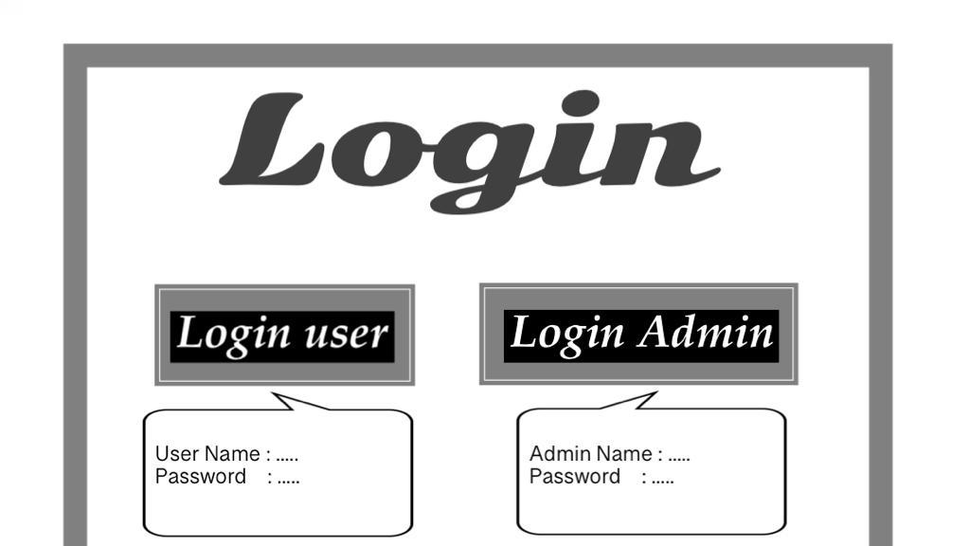

Slide 6
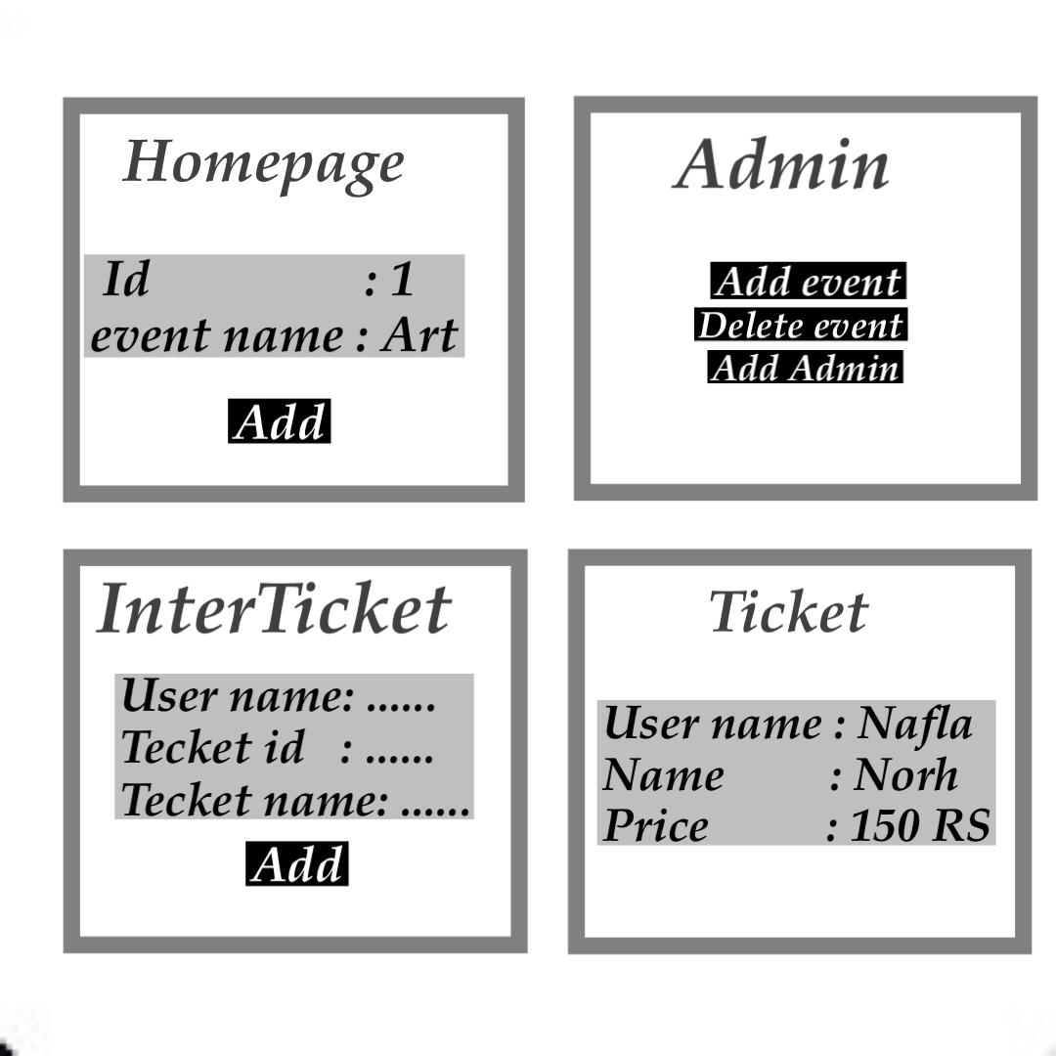

Slide 7
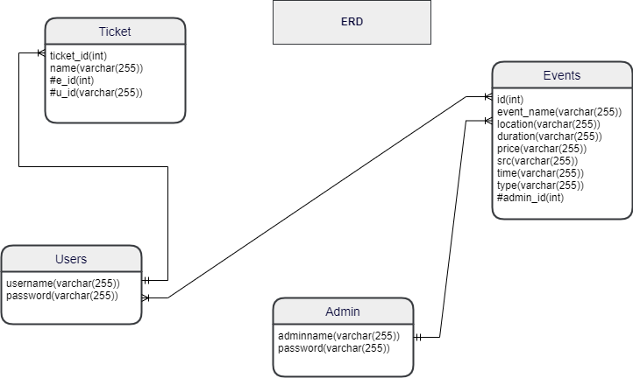

Slide 8
Demo of the project..

Slide 9
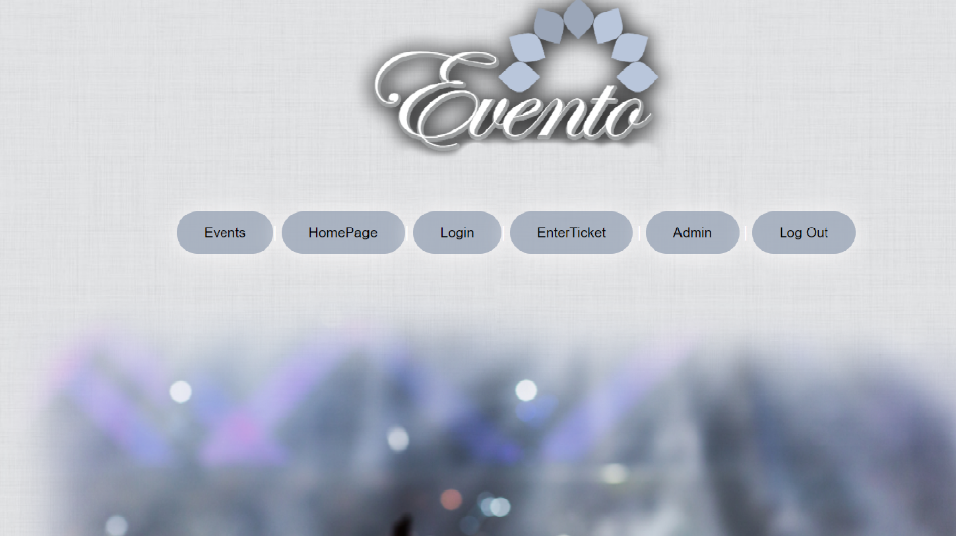

Slide 10

Events Announcements..

Slide 11
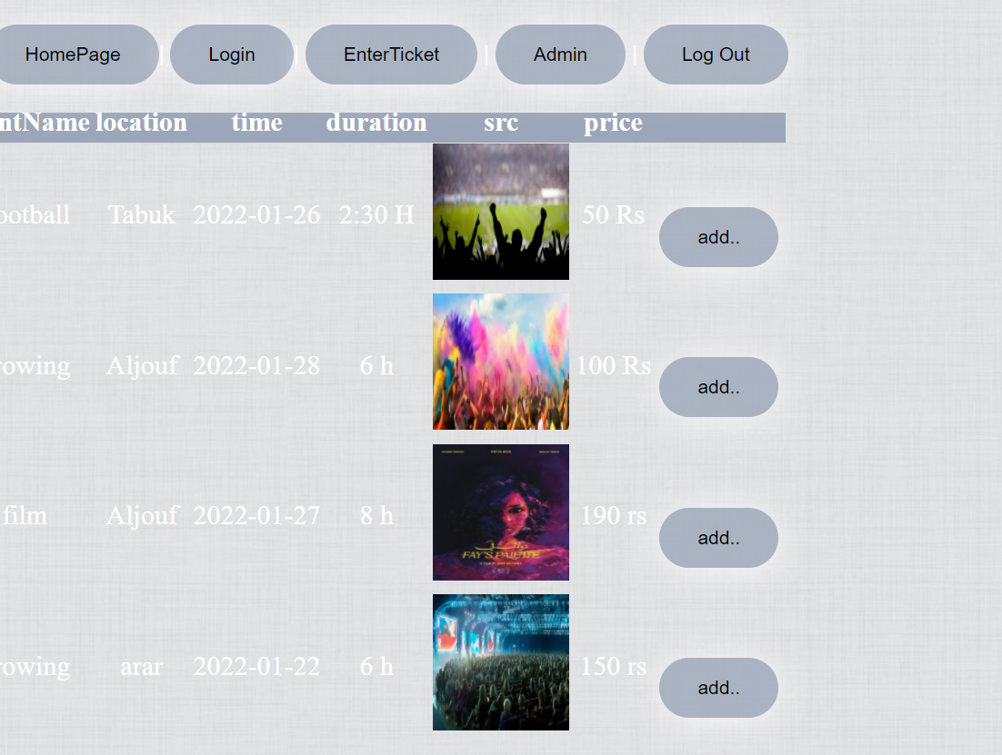
This page displays the events by the admin..

Slide 12
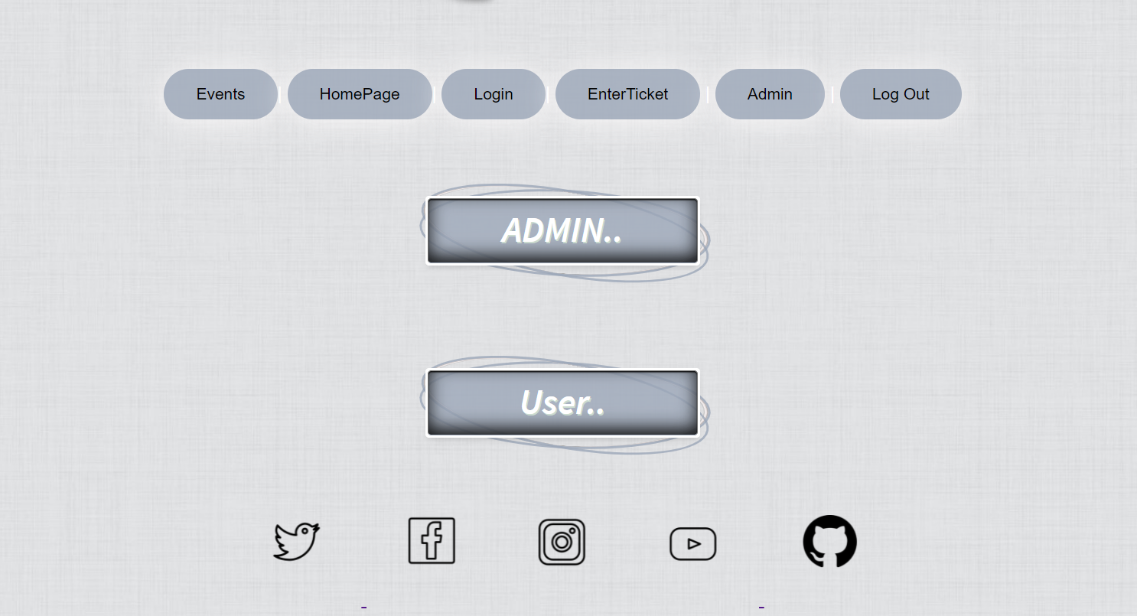

Slide 13
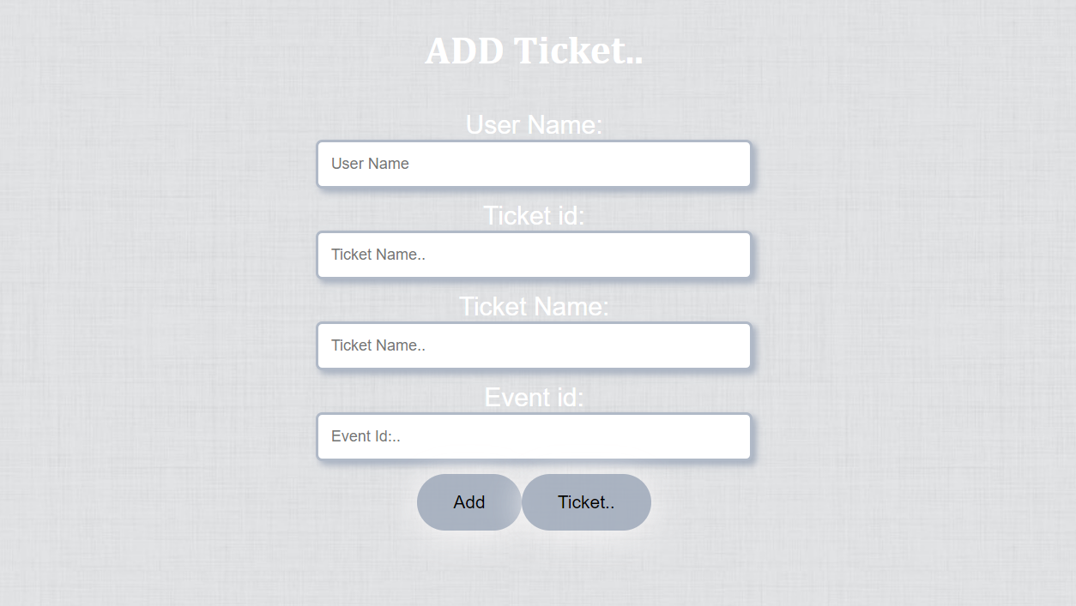

Slide 14


Slide 15
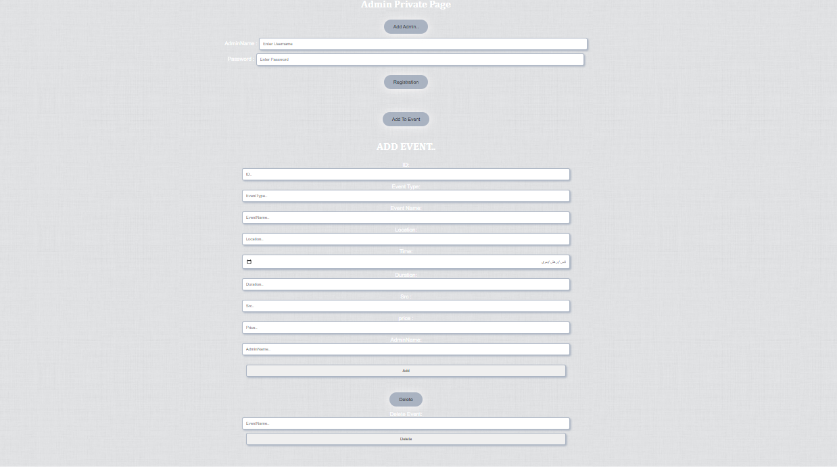

Slide 16
Technologies used..
The back was created using MySQL and Java Spring.
The front was created using React JavaScript and HTML and styled using CSS.

Slide 17
What was the most difficult part of the project?
It is not difficult, but the front is more complicated .

Slide 18
What was your favorite part of the project?
DB and creat tables

Slide 19
What are the new things you learned creating this application?
Build a complete a full stack web application

Slide 20
The Reviewer..
https://www.w3schools.com
https://stackoverflow.com/questions/42488559/manytomany-relationship-between-three-tables
https://masteringjs.io/tutorials/axios/get-query-params
https://codepen.io

Slide 21
